Slide 1
TOPIC No 2
Queues

Slide 2


Queues
Linear list.
One end is called front.
Other end is called rear.
Additions are done at the rear only.
Removals are made from the front only.
Notes:
By comparison, in a stack adds and removes are to/from the same end of he list.

Slide 3







Bus Stop Queue
Bus Stop
front
rear
rear
rear
rear
rear

Slide 4
Bus Stop Queue
Bus Stop
front
rear
rear
rear

Slide 5
Bus Stop Queue
Bus Stop
front
rear
rear

Slide 6

Bus Stop Queue
Bus Stop
front
rear
rear
Notes:
This is FIFO queue. Some real life queues are not FIFO. Removal from a queue may be done by priority rather than by arrival time order. For example, loading into a plane– first class, frequent fliers, by rows from back of plane rather than by order in which you arrive at the departure gate.

Slide 7
Introduction
Queue is an important data structure which stores its elements in an ordered manner.
We can explain the concept of queues using the following analogy:
People moving on an escalator. The people who got on the escalator first will be the first one to step out of it.
A queue is a FIFO (First-In, First-Out) data structure in which the element that is inserted first is the first one to be taken out.
The elements in a queue are added at one end called the rear and removed from the other one end called the front.

Slide 8
Applications of Queues
Queues are widely used as waiting lists for a single shared resource like printer, disk, CPU.
Queues are used to transfer data asynchronously e.g., pipes, file IO, sockets.
Queues are used as buffers on MP3 players and portable CD players, iPod playlist.
Queues are used in Playlist for jukebox to add songs to the end, play from the front of the list.
Queues are used in OS for handling interrupts. When programming a real-time system that can be interrupted, for ex, by a mouse click, it is necessary to process the interrupts immediately before proceeding with the current job. If the interrupts have to be handled in the order of arrival, then a FIFO queue is the appropriate data structure

Slide 9
Array Representation of Queues
Queues can be easily represented using linear arrays.
Every queue has front and rear variables that point to the position from where deletions and insertions can be done, respectively.
Consider the queue shown in figure
12 | 9 | 7 | 18 | 14 | 36
0 1 2 3 4 5 6 7 8 9
Here, front = 0 and rear = 5.
If we want to add one more value in the list say with value 45, then rear would be incremented by 1 and the value would be stored at the position pointed by rear.
12 | 9 | 7 | 18 | 14 | 36 | 45
0 1 2 3 4 5 6 7 8 9

Slide 10
Array Representation of Queues
Now, front = 0 and rear = 6. Every time a new element has to be added, we will repeat the same procedure.
Now, if we want to delete an element from the queue, then the value of front will be incremented. Deletions are done from only this end of the queue.
 | 9 | 7 | 18 | 14 | 36 | 45
0 1 2 3 4 5 6 7 8 9
Now, front = 1 and rear = 6.

Slide 11
Array Representation of Queues
Before inserting an element in the queue we must check for overflow conditions.
An overflow occurs when we try to insert an element into a queue that is already full, i.e. when rear = MAX – 1, where MAX specifies the maximum number of elements that the queue can hold.
Similarly, before deleting an element from the queue, we must check for underflow condition.
An underflow occurs when we try to delete an element from a queue that is already empty. If front = -1 and rear = -1, this means there is no element in the queue.

Slide 12
Algorithm for Insertion Operation
Algorithm to insert an element in a queue
Step 1: IF REAR=MAX-1, then;
Write OVERFLOW
Goto Step 4
[END OF IF]
Step 2: IF FRONT == -1 and REAR = -1, then
SET FRONT = REAR = 0
ELSE
SET REAR = REAR + 1
[END OF IF]
Step 3: SET QUEUE[REAR] = NUM
Step 4: Exit

Slide 13
Algorithm for Deletion Operation
Algorithm to delete an element from a queue
Step 1: IF FRONT = -1 OR FRONT > REAR, then
Write UNDERFLOW
Goto Step 2
ELSE
SET VAL = QUEUE[FRONT]
SET FRONT = FRONT + 1
[END OF IF]
Step 2: Exit

Slide 14
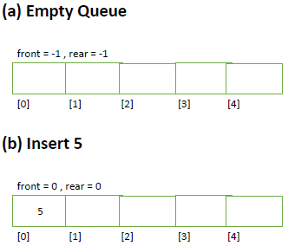
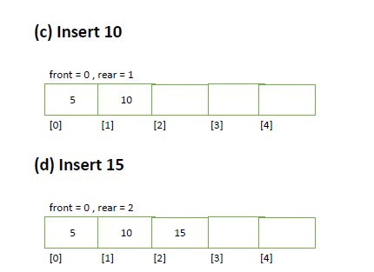

Slide 15
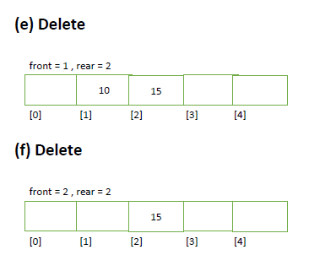
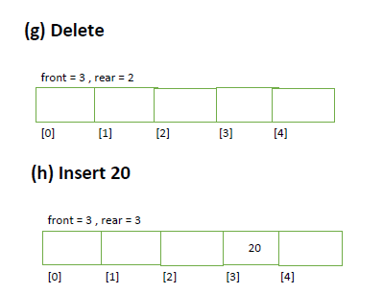

Slide 16
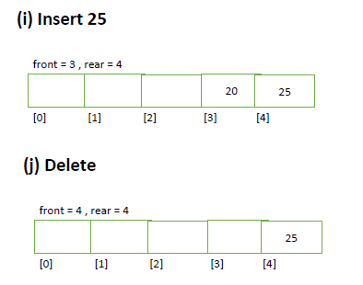
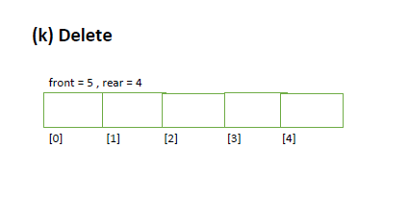

Slide 19
Linked Representation of Queues
In a linked queue, every element has two parts: one that stores data and the other that stores the address of the next element.
The START pointer of the linked list is used as FRONT.
We will also use another pointer called REAR which will store the address of the last element in the queue.
All insertions will be done at the rear end and all the deletions will be done at the front end.
If FRONT = REAR = NULL, then it indicates that the queue is empty.
1
7
3
4
2
6
5
X
FRONT
REAR

Slide 20
Inserting an Element in a Linked Queue
Algorithm to insert an element in a linked queue
Step 1: Allocate memory for the new node and name it as PTR
Step 2: SET PTR->DATA = VAL
Step 3: IF FRONT = NULL, then
SET FRONT = REAR = PTR
SET FRONT->NEXT = REAR->NEXT = NULL
ELSE
SET REAR->NEXT = PTR
SET REAR = PTR
SET REAR->NEXT = NULL
[END OF IF]
Step 4: END

Slide 21
Deleting an Element from a Linked Queue
Algorithm to delete an element from a linked queue
Step 1: IF FRONT = NULL, then
Write “Underflow”
Go to Step 5
[END OF IF]
Step 2: SET PTR = FRONT
Step 3: FRONT = FRONT->NEXT
Step 4: FREE PTR
Step 5: END

Slide 22
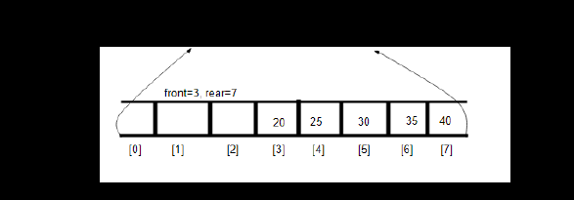
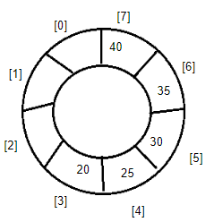
CIRCULAR QUEUE

Slide 23
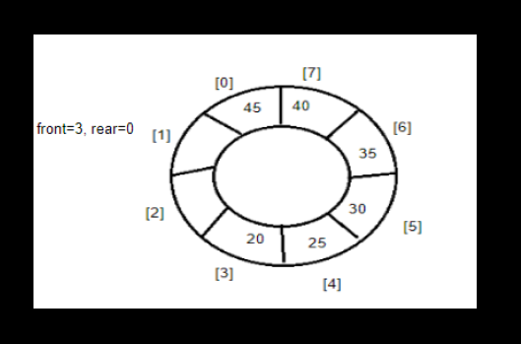

Slide 24
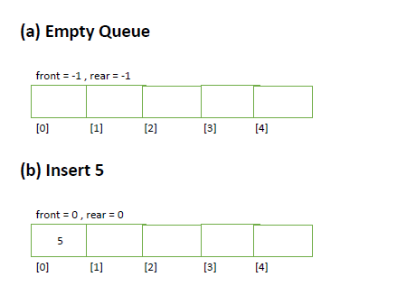
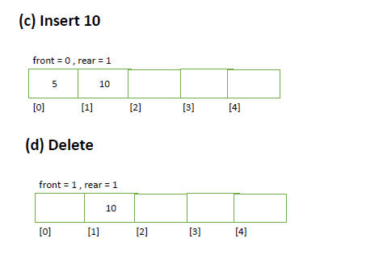

Slide 25
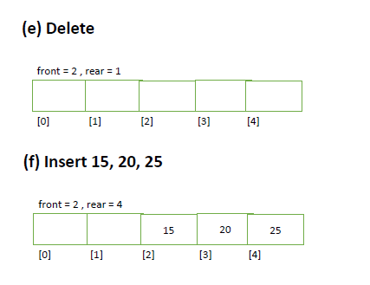
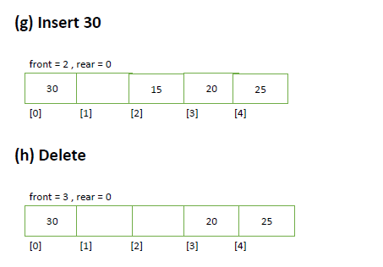

Slide 26
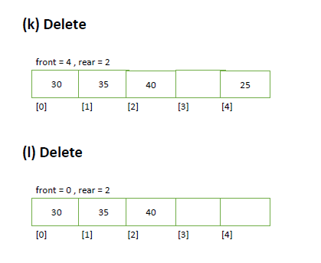
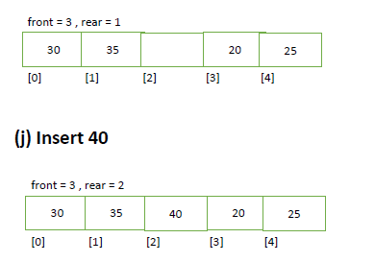

Slide 28
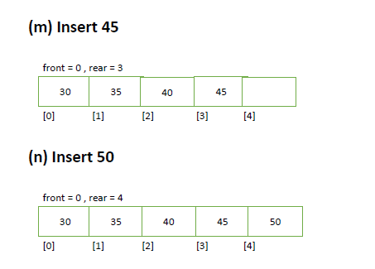
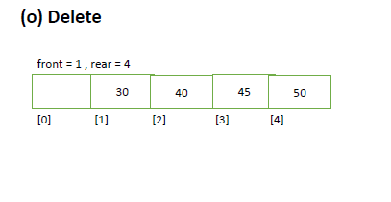

Slide 29
Circular Queues
 |  | 7 | 18 | 14 | 36 | 45 | 21 | 99 | 72
0 1 2 3 4 5 6 7 8 9
We will explain the concept of circular queues using an example.
In this queue, front = 2 and rear = 9.
Now, if you want to insert a new element, it cannot be done because the space is available only at the left of the queue.
If rear = MAX – 1, then OVERFLOW condition exists.
This is the major drawback of a linear queue. Even if space is available, no insertions can be done once rear is equal to MAX – 1.
This leads to wastage of space. In order to overcome this problem, we use circular queues.
In a circular queue, the first index comes right after the last index.
A circular queue is full, only when front=0 and rear = Max – 1.

Slide 30
Inserting an Element in a Circular Queue
For insertion we check for three conditions which are as follows:
If front=0 and rear= MAX – 1, then the circular queue is full.
90 | 49 | 7 | 18 | 14 | 36 | 45 | 21 | 99 | 72
front=0 1 2 3 4 5 6 7 8 rear = 9
If rear != MAX – 1, then the rear will be incremented and value will be inserted
90 | 49 | 7 | 18 | 14 | 36 | 45 | 21 | 99
front=0 1 2 3 4 5 6 7 rear= 8 9
If front!=0 and rear=MAX -1, then it means that the queue is not full. So, set rear = 0 and insert the new element.
 | 49 | 7 | 18 | 14 | 36 | 45 | 21 | 99 | 72
front=1 2 3 4 5 6 7 8 rear= 9

Slide 31
Algorithm to Insert an Element in a Circular Queue
Step 1: IF FRONT = 0 and Rear = MAX – 1, then
Write “OVERFLOW”
Goto Step 4
[END OF IF]
Step 2: IF FRONT = -1 and REAR = -1, then;
SET FRONT = REAR = 0
ELSE IF REAR = MAX – 1 and FRONT != 0
SET REAR = 0
ELSE
SET REAR = REAR + 1
[END OF IF]
Step 3: SET QUEUE[REAR] = VAL
Step 4: Exit

Slide 32
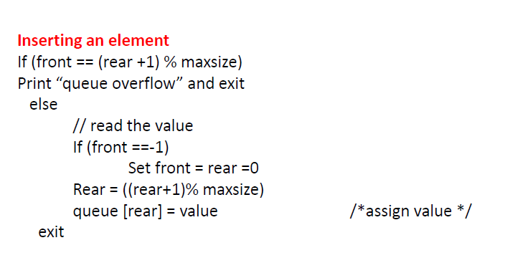

Slide 33
Deleting an Element from a Circular Queue
To delete an element again we will check for three conditions:
If front = -1, then it means there are no elements in the queue. So an underflow condition will be reported.
0 1 2 3 4 5 6 7 8 9
If the queue is not empty and after returning the value on front, if front = rear, then it means now the queue has become empty and so front and rear are set to -1.
 |  |  |  |  |  |  |  |  | 81
Delete this element and set rear = front = -1
0 1 2 3 4 5 6 7 8 front=rear= 9
If the queue is not empty and after returning the value on front, if front = MAX -1, then front is set to 0.
72 | 63 | 9 | 18 | 27 | 39 |  |  |  | 81
0 1 2 3 4 rear= 5 6 7 8 front= 9

Slide 34
Algorithm to Delete an Element from a Circular Queue
Step 1: IF FRONT = -1, then
Write “Underflow”
Goto Step 4
[END OF IF]
Step 2: SET VAL = QUEUE[FRONT]
Step 3: IF FRONT = REAR
SET FRONT = REAR = -1
ELSE
IF FRONT = MAX -1
SET FRONT = 0
ELSE
SET FRONT = FRONT + 1
[END OF IF]
[END OF IF]
Step 4: EXIT

Slide 35
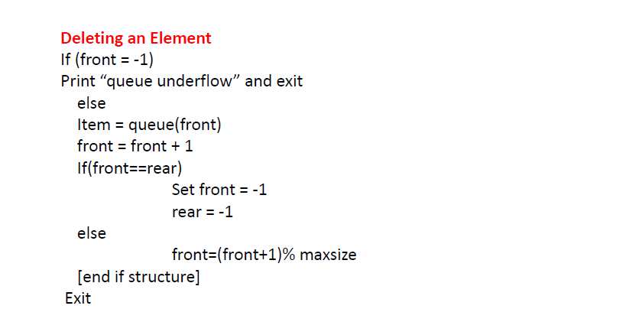

Slide 36
Deques
A deque is a list in which elements can be inserted or deleted at either end.
It is also known as a head-tail linked list because elements can be added to or removed from the front (head) or back (tail).
A deque can be implemented either using a circular array or a circular doubly linked list.
In a deque, two pointers are maintained, LEFT and RIGHT which point to either end of the deque.
The elements in a deque stretch from LEFT end to the RIGHT and since it is circular, Dequeue[N-1] is followed by Dequeue[0].

Slide 37
Deques
There are two variants of a double-ended queue:
Input restricted deque: In this dequeue insertions can be done only at one of the ends while deletions can be done from both the ends.
Output restricted deque: In this dequeue deletions can be done only at one of the ends while insertions can be done on both the ends.
 |  |  | 29 | 37 | 45 | 54 | 63
0 1 2 LEFT = 3 4 5 6 RIGHT = 7 8 9
42 |  |  |  |  |  |  | 63 | 27 | 18
RIGHT = 0 1 2 3 4 5 6 LEFT = 7 8 9

Slide 38
Priority Queues
A priority queue is a queue in which each element is assigned a priority.
The priority of elements is used to determine the order in which these elements will be processed.
The general rule of processing elements of a priority queue can be given as:
  An element with higher priority is processed before an element with lower priority
  Two elements with same priority are processed on a first come first served (FCFS) basis
Priority queues are widely used in operating systems to execute the highest priority process first.
In computer’s memory priority queues can be represented using arrays or linked lists.

Slide 39
Linked Representation of Priority Queues
When a priority queue is implemented using a linked list, then every node of the list contains three parts: (1) the information or data part, (ii) the priority number of the element, (iii) and address of the next element.
If we are using a sorted linked list, then element having higher priority will precede the element with lower priority.
A
1
B
2
C
3
D
3
E
4
X
Priority queue after insertion of a new node
A
1
B
2
C
3
F
4
D
5
E
6
X

Slide 40
Array Representation of Priority Queues
When arrays are used to implement a priority queue, then a separate queue for each priority number is maintained.
Each of these queues will be implemented using circular arrays or circular queues. Every individual queue will have its own FRONT and REAR pointers.
We can use a two-dimensional array for this purpose where each queue will be allocated same amount of space.
Given the front and rear values of each queue, a two dimensional matrix can be formed.

Slide 41
Multiple Queues
When implementing a queue using an array, the size of the array must be known in advance.
If the queue is allocated less space, then frequent OVERFLOW conditions will be encountered.
To deal with this problem, the code will have to be modified to reallocate more space for the array, but this results in sheer wastage of memory. Thus, there lies a tradeoff between the frequency of overflows and the space allocated.
A better solution to deal with this problem is to have multiple queues or to have more than one queue in the same array.
One important point to note is that while queue A will grow from left to right, the queue B on the same time will grow from right to left.
0 1 2 3 4 ………………………………. n-4 n-3 n-2 n-1
Queue A Queue B

